Slide 1
Network and Communication Protocol

Slide 2
Network Building Blocks
Network Classifications
LAN Standards
Network Devices
Clients, Servers, and Peers
Physical Topology
Network Links
Communications Protocols

Slide 3
Network Classifications
Personal Area Network (PAN) – interconnection of personal digital devices
Neighborhood Area Network (NAN) – connectivity spread over several buildings
Local Area Network (LAN) – usually connects computers in a single building
Metropolitan Area Network (MAN) – public high-speed network with range of about 50 miles
Wide Area Network (WAN) – consists of several smaller networks

Slide 4
LAN Standards
LAN technologies are standardized by the Institute of Electrical and Electronics Engineers (IEEE) Project 802 – Local Network Standards
  IEEE 802.3
  Ethernet
Notes:
The IEEE 802 Standard comprises a family of networking standards that cover the physical layer specifications of technologies from Ethernet to wireless. IEEE 802 is subdivided into 22 parts that cover the physical and data-link aspects of networking.
Ethernet is a system for connecting a number of computer systems to form a local area network, with protocols to control the passing of information and to avoid simultaneous transmission by two or more systems.

Slide 5
Network Devices
Each connection point on a network is referred to as a node
To connect to a LAN, a computer requires network circuitry, sometimes referred to as a network interface card (NIC)
A networked peripheral, or network-enabled peripheral, is any device that contains network circuitry to directly connect to a network
A network device, or network appliance, is any electronic device that broadcasts network data, boosts signals, or routes data to its destination
Notes:
A network interface card (NIC) is a hardware component, typically a circuit board or chip, which is installed on a computer so that it can connect to a network. ... Each card represents a device and can prepare, transmit and control the flow of data on the network.

Slide 6
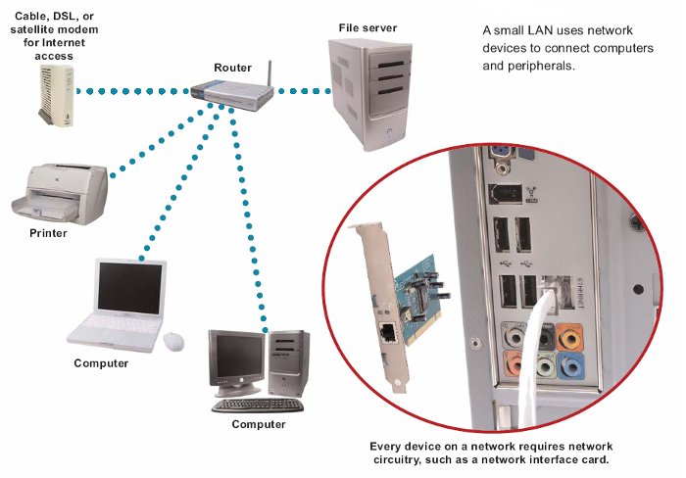
Network Devices

Slide 7
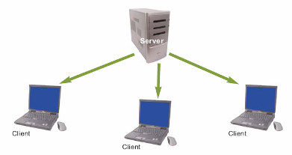
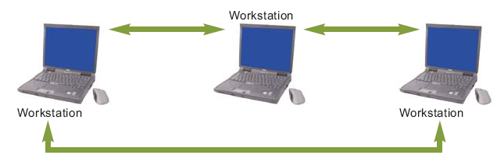
Clients, Servers, and Peers
Network devices can function as clients or as servers
  Application server
  File server
  Print server
Networks that include one or more servers can operate in client/server mode
Notes:
An application server is a software framework that provides both facilities to create web applications and a server environment to run them.
A file server is a computer attached to a network that provides a location for shared disk access, i.e. shared storage of computer files that can be accessed by the workstations that are able to reach the computer that shares the access through a computer network.
A print server, or printer server, is a device that connects printers to client computers over a network. It accepts print jobs from the computers and sends the jobs to the appropriate printers, queuing the jobs locally to accommodate the fact that work may arrive more quickly than the printer can actually handle.

Slide 8
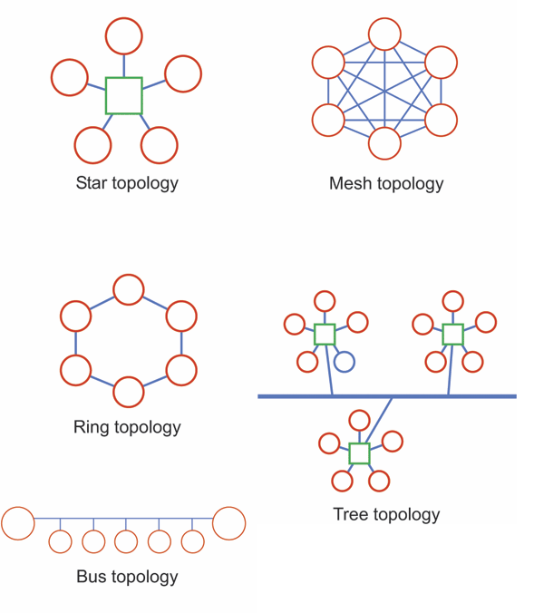
Physical Topology
The arrangement of devices in a network is referred to as its physical topology
  Star
  Ring
  Bus
  Mesh
  Tree
Two similar networks can
be connected by a device
called a bridge
Gateway is a generic term
for any device or software
code used to join two networks
Notes:
Figure 5-6

Slide 9
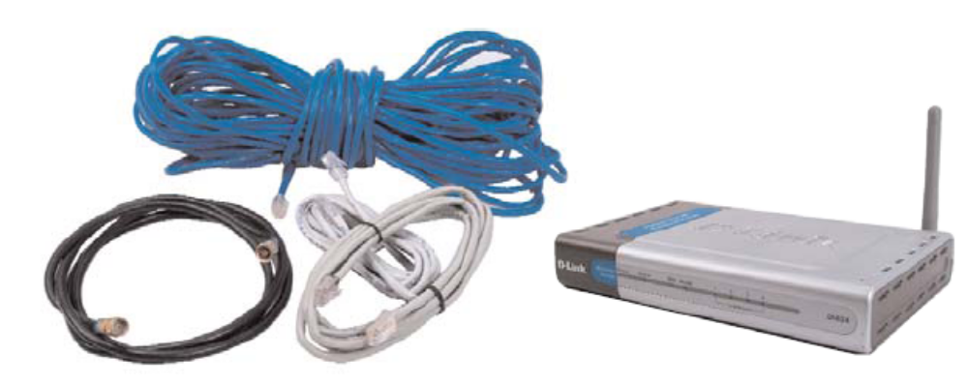
Network Links
A communications channel, or link, is a physical path or frequency for signal transmissions
Bandwidth is the transmission capacity of a communications channel
  Broadband
  Narrowband
Notes:
1. Narrowband communications use a smaller frequency range (bandwidth) compared to broadband communications.
2. In internet access, broadband technologies provide higher data rate in terms of Mbps, whereas narrowband connections provide slower data rate such as 56 kbps.
3. In radio communications, bandwidth is smaller than the coherence bandwidth of the channel for narrowband, and wider for broadband.

Slide 10
Communications Protocols
Rules for efficiently transmitting data from one network node to another
  Divide messages into packets
  Affix addresses to packets
  Initiate transmission
  Regulate flow of data
  Check for transmission errors
  Acknowledge receipt of transmitted data
Notes:
A communication protocol is a system of rules that allow two or more entities of a communications system to transmit information via any kind of variation of a physical quantity.

Slide 11
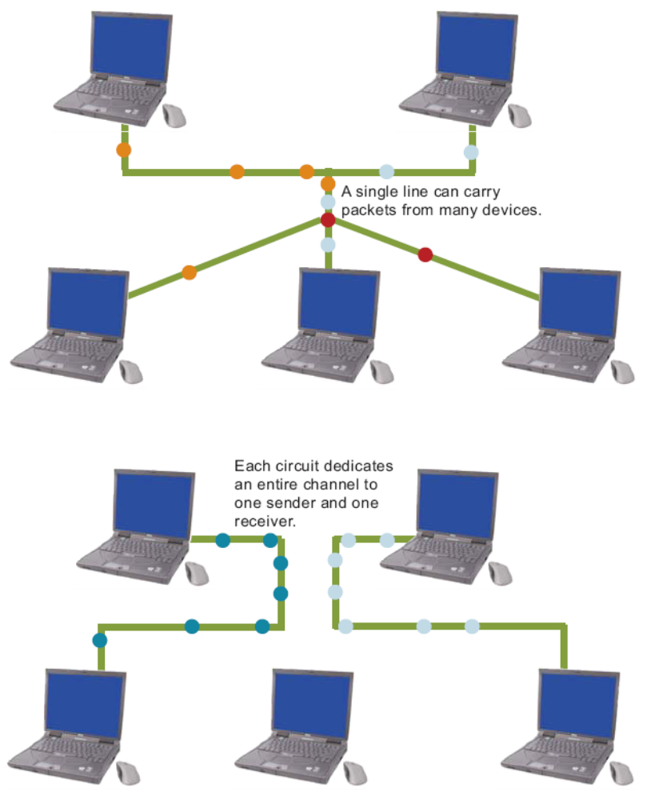
Communications Protocols
A packet is a “parcel” of data that is sent across a computer network
  Circuit-switching technology vs. packet switching technology
Notes:
Circuit Switching is connection oriented that means a path is established between source and destination before the transmission occurs. On the other hand, Packet Switching is Connectionless that means a dynamic route is decided for each packet while transmission.

Slide 12
Communications Protocols
Every packet that travels over a network includes the address of its destination device
A MAC address is a unique number assigned to a network interface card when it is manufactured
An IP address is a series of numbers used to identify a network device
IP addresses can also be obtained through DHCP
Notes:
Short for medium access control, or MAC address. MAC and IP are the addresses that uniquely defines a device and a connection in a network. A MAC address is a number assigned to the NIC card by the manufacturer. IP address is a number assigned to the connection in a network.
Dynamic Host Configuration Protocol (DHCP) is a protocol for assigning dynamic IP addresses to devices on a network. With dynamic addressing, a device can have a different IP address every time it connects to the network. In some systems, the device's IP address can even change while it is still connected.

Slide 13
Wired Network Basics
A wired network uses cables to connect network devices
Wired networks are fast, secure, and simple to configure

Slide 14
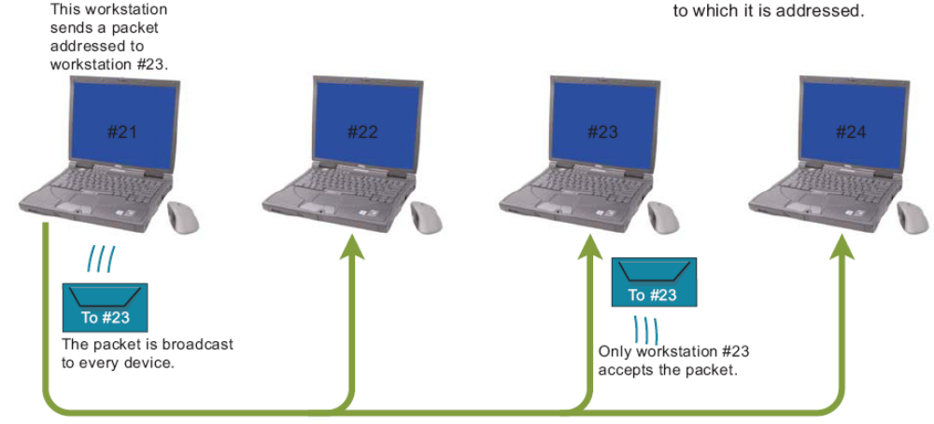
Ethernet
Simultaneously broadcasts data packets to all network devices
  IEEE 802.3
  CSMA/CD protocol
Vary in speed from 10Mbps to 10Gbps
Notes:
CSMA/CD. Short for carrier sense multiple access/collision detection, CSMA/CD is a MAC (media access control) protocol. It defines how network devices respond when two devices attempt to use a data channel simultaneously and encounter a data collision.

Slide 15
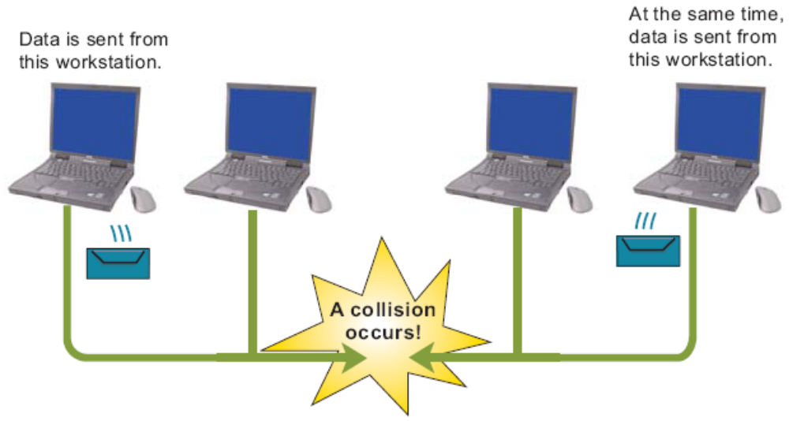
Ethernet
On an Ethernet, data travels on a first come, first served basis. If two workstations attempt to send data at the same time, a collision occurs.
That data must be resent.

Slide 16
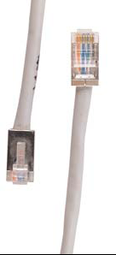
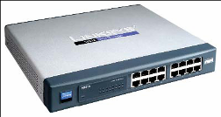
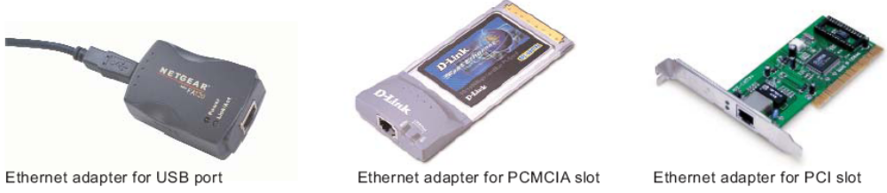
Ethernet Equipment
Ethernet adapter (designed to support the Ethernet protocols)
Network hub
Network switch
Network router
RJ45 connector

Slide 17
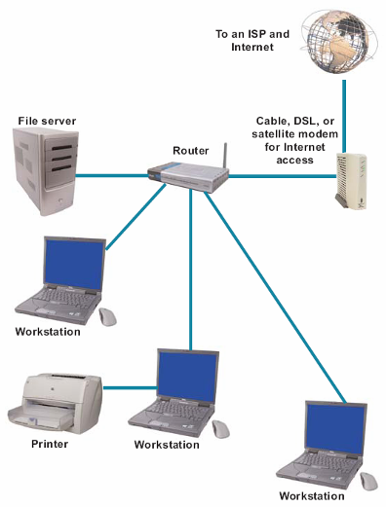
Ethernet Setup

Slide 18
Wireless Networks
Wireless Basics
Bluetooth
Wi-Fi
Wi-Fi Equipment
Wi-Fi Setup
Notes:
The main difference between Bluetooth and Wifi is the purpose behind its designing. Bluetooth is essentially used to connect short-range devices for sharing data while Wifi provides high-speed internet access. ... Bluetooth is used when speed is not our concern and low bandwidth is allocated to it.

Slide 19
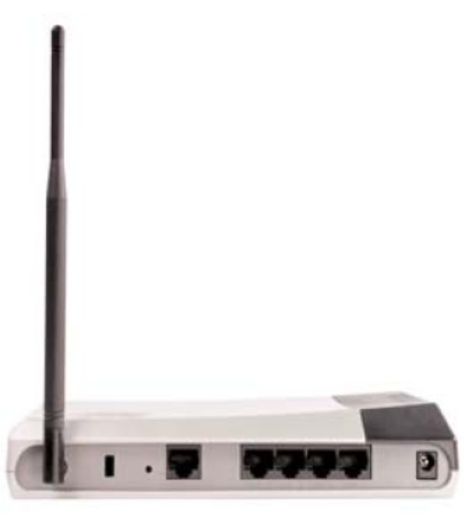
Wireless Basics
A wireless network transports data from one device to another without cables or wires
  RF signals
    Transceiver
  Microwaves
  Infrared light
Slower than wired networks
Security concerns
Notes:
An RF signal is an electromagnetic wave that communications systems use to transport information through air from one point to another. RF signals have been in use for many years. They provide the means for carrying music to FM radios and video to televisions.
Microwave is a line-of-sight wireless communication technology that uses high frequency beams of radio waves to provide high speed wireless connections that can send and receive voice, video, and data information.
In communications and networking, infrared light is used in wired and wireless operations. Remote controls use near-infrared light, transmitted with light-emitting diodes (LEDs), to send focused signals to home-entertainment devices, such as televisions.

Slide 20


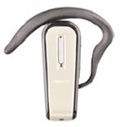
Bluetooth
Bluetooth is a short-range, wireless network technology designed to make its own connections between electronic devices, without wires, cables, or any direct action from a user

Slide 21
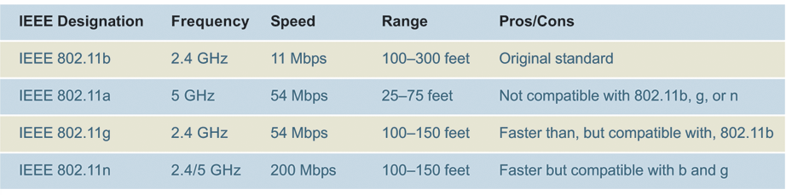
Wi-Fi
Wireless networking technologies that are compatible with Ethernet
MIMO technology uses two or more antennae to send multiple sets of signals

Slide 22
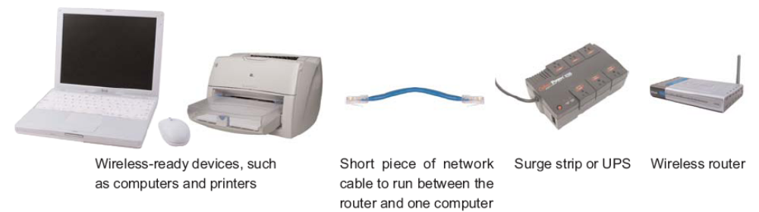
Wi-Fi Equipment

Slide 23
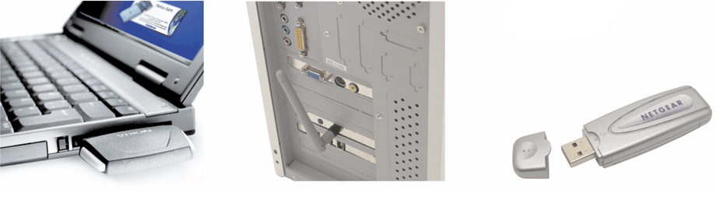
Wi-Fi Equipment
If your computer is not pre-equipped with wireless circuitry, you can purchase and install a Wi-Fi card

Slide 24
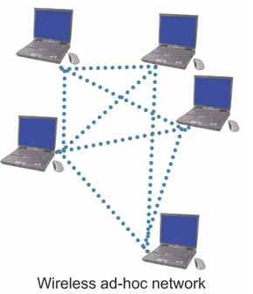
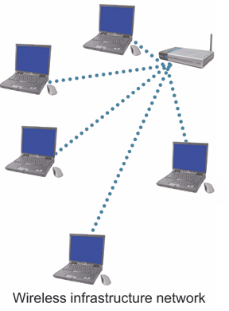
Wi-Fi Equipment
Wireless network setups
  Wireless ad-hoc network
  Wireless infrastructure network
    Wireless
    access point
    Wireless
    router

Slide 25
Wi-Fi Setup
Set up the router
Connect to the router with a computer
Configure the router
Access the router setup utility
Create a new router password

Slide 26
Wi-Fi Setup
Enter an SSID for the network
Activate WEP, WPA, or WPA2 and create an encryption key
Set up the wireless workstations
Connect an Internet access device
Notes:
SSID. (Service Set IDentifier) The name assigned to a Wi-Fi (wireless) network. All devices in the network must use this case-sensitive name to communicate over Wi-Fi, which is a text string up to 32 bytes long.
WEP stands for Wired Equivalent Privacy, and WPA stands for Wireless Protected Access. WPA2 is the second version of the WPA standard. Using some encryption is always better than using none, but WEP is the least secure of these standards, and you should not use it if you can avoid it.
WPS stands for Wi-Fi Protected Setup. It is a wireless network security standard that tries to make connections between a router and wireless devices faster and easier. WPS works only for wireless networks that use a password that is encrypted with the WPA Personal or WPA2 Personal security protocols.

Slide 27
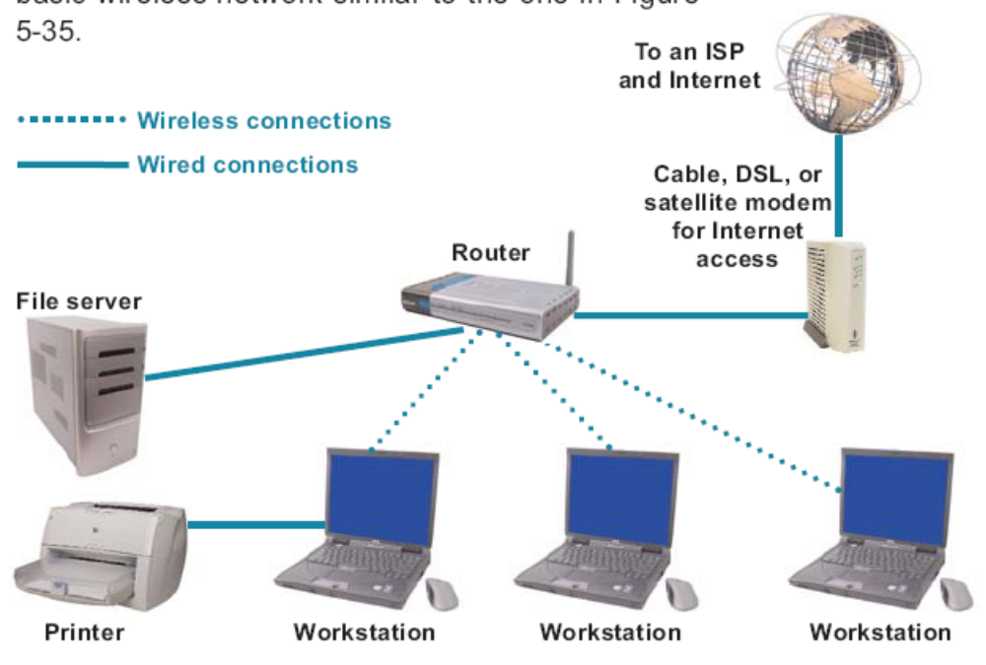
Wi-Fi Setup

Slide 28
Using LANs
LAN Advantages and Challenges
Sharing Files
Sharing Printers
LAN Parties
Troubleshooting

Slide 29
LAN Advantages and Challenges
LANs enable people to work together
Sharing networked software can reduce costs
Sharing data on a LAN can increase productivity
Sharing networked hardware can reduce costs
Sharing networked hardware can provide access to a wide range of services and specialized peripheral devices

Slide 30
LAN Advantages and Challenges
Resources become unavailable when network malfunctions
Networks may be vulnerable to unauthorized access
  More vulnerable than standalone computers
Wireless networks can be tapped from a “snooping” computer
Networked computers are susceptible to an increasing number of worms, Trojan horses, and blended threats

Slide 31
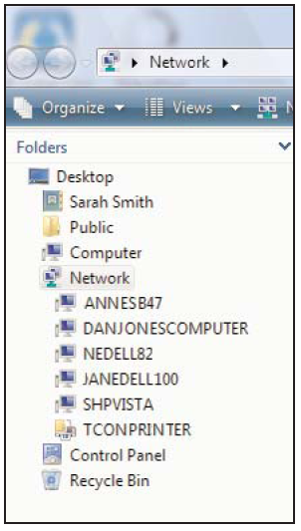
Sharing Files
If you use Windows, it automatically detects available LANs any time you turn on a workstation
To connect to a shared resource, you might be asked for a user ID and password

Slide 32
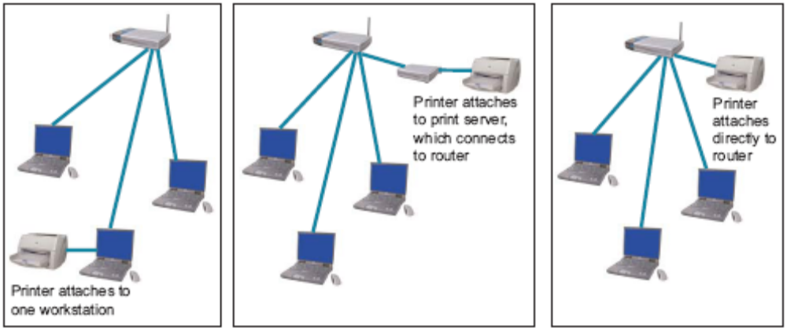
Sharing Printers
Three setups allow for printer sharing:
  Set up printer sharing using a workstation printer
  Set up printer sharing using a print server
  Install printer with built-in networking

Slide 33
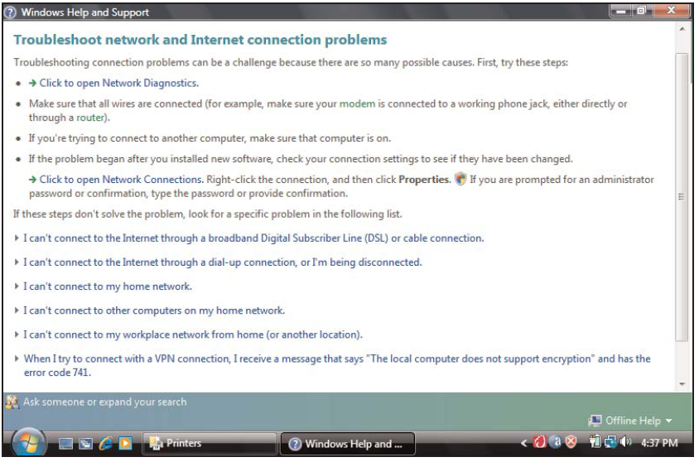
Troubleshooting
Network problems can stem from a variety of sources
  Cables
  Signal strength
  Security
  Interference
  Network devices
  Settings

Slide 34
Security Through Encryption
Wi-Fi Security
Encryption
Notes:
Network encryption is the process of encrypting or encoding data and messages transmitted or communicated over a computer network. It is a broad process that includes various tools, techniques and standards to ensure that the messages are unreadable when in transit between two or more network nodes.

Slide 35
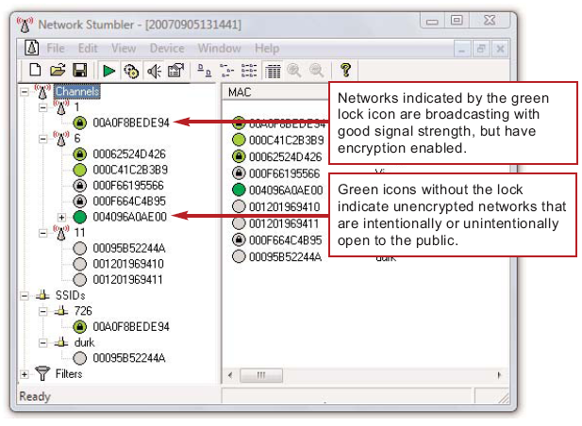
Wi-Fi Security
Wireless networks are much more susceptible to unauthorized access and use than wired networks
LAN jacking, or war driving, is the practice of intercepting wireless signals by cruising through an area
Notes:
War Driving or LAN Jacking
With the advent of wireless networking, there has been a rise in a new form of cracking called "WarDriving" or "LanJacking." Crackers will drive around with a laptop computer equipped with a wireless network card in search of unsecured wireless networks.

Slide 36
Wi-Fi Security
Wireless encryption scrambles data transmitted between wireless devices and then unscrambles the data only on devices that have a valid encryption key
  WEP (Wired Equivalent Privacy)
  WPA (Wi-Fi Protected Access)
  WPA2
Activate encryption by using a wireless network key

Slide 37
Encryption
Encryption transforms a message so that its contents are hidden from unauthorized readers
  Plaintext has not yet been encrypted
  An encrypted message is referred to as ciphertext
Decryption is the opposite of encryption
  Cryptographic algorithm
  Cryptographic key

